Slide 1
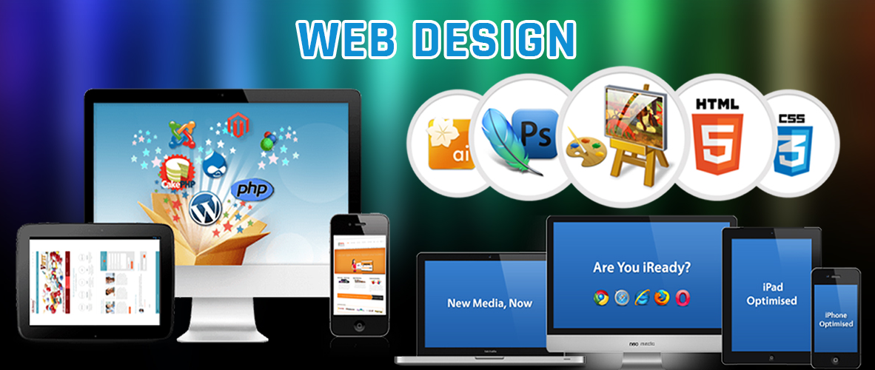
OCR Level 02 – Cambridge Technical
Unit 13 – Creating Websites
2016 Specification - T/615/1382
LO1 - Know how websites are used by organisations

Slide 2
Assessment Criteria
The Learner will | Pass The assessment criteria are the pass requirements for this unit. The learner can: | Merit To achieve a merit the evidence must show that, in addition to the pass criteria, the learner is able to: | Distinction To achieve a distinction the evidence must show that, in addition to the pass and merit criteria, the learner is able to:
1 - Know how websites are used by organisations | P1 - Describe the uses of websites in organisations
2 - Be able to review existing websites in relation to business needs | P2 - Review an existing website used for a specified business need | M1 - Be able to review existing websites in relation to business needs
 | P3Prepare a plan for realising improvements or enhancements to the specified website
3 - Be able to create or modify components of websites to meet business needs | P4 - Create or modify website components | M2 - Present website components to stakeholders for approval | D1 - Recommend changes to website components based on stakeholder feedback
4 - Be able to update websites to meet business needs | P5 - Update website with developed or modified components | M3 - Test functionality of updated website and resolve any issues
 | P6 - Present updated website to stakeholders |  | D2 - Evaluate the updated website against the needs of the business

Slide 3
Aim and Purpose
e
Learning Outcome 1: Know how websites are used by organisations
Your task is to: describe the role that websites play in the support of the operational activities of organisations.
The SMT at Progress Academy would like to understand how the possible use of a website could be beneficial to the daily operation of the Academy.
In order to consider the potential benefits of using websites, you have been asked by the SMT to research a range of existing websites that are currently being used by organisations and describe the potential benefits that websites provide to these organisations.
This information will be given to the SMT of Progress Academy to clarify the benefits that websites may provide.
This must include:
a range of appropriate websites;
benefits and advantages to organisations of using websites;
how websites support the business functions of organisations. Note – Any websites used must be clearly identified by the name of the site with the hyperlink included.

Slide 4
Assessment Criterion P1
P1 - Learners must describe how websites are used by organisations. Evidence could be in the form of a report, presentation with speaker notes, a video of presenting the information to an audience, or an information guide.
P1 - Uses of websites in organisations, e.g.:
  marketing
  sales
  information
  e-commerce
  support services
  financial
  intranets
  collaboration
What makes a good website Offline vs online web creation Do people still use HTML to write websites Are all websites made the same way Can I make a website as good as Amazon How many pages does a website need to have What is HTML5.

Slide 5
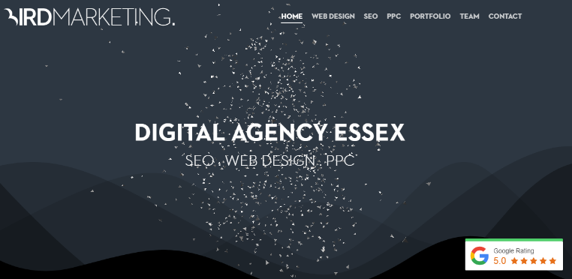

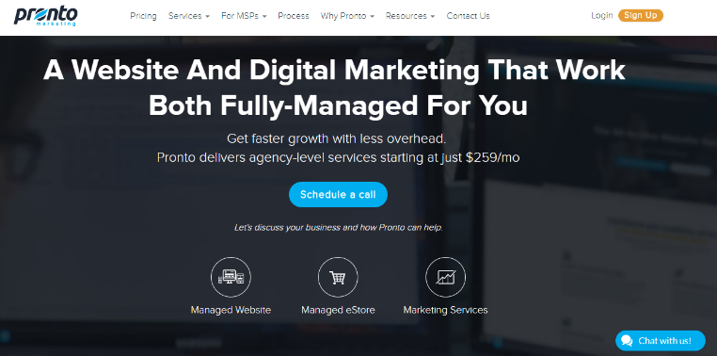
P1.1 – Marketing
Marketing websites provide a presence for a business. It’s the online equivalent of owning a high street shop or prominent office and therefor showing what a company can do is an easy medium online.
On many occasions it is the centre of a business’ universe and is generally the place where other marketing activity is attempting to drive traffic to.
Online marketing of a company should include brand, purpose, ethos, a gallery to showcase a company, a contact portal to keep in touch with a company and media to demonstrate the company.
All these are easy tools to incorporate by modern standards. Look at the marketing sites on the right and how it is laid out, the features shown, the words that are written.
https://birdmarketing.co.uk/
https://www.fifteendesign.co.uk/
https://www.prontomarketing.com/

Slide 6
P1.1 – Marketing
P1.1 – Task 01 – Using an example, identify the purpose, provision, advantages and benefits, and company support marketing websites give to a business.
For this you should explain a particular website, the web address, the features shows on the home and advanced pages, what the website is trying to sell you and what features are provided.
For each of the provided features demonstrate what they are, what they do and how they benefit the purpose of the business. Why might they compare to an offline version of the site, how does it speed up or save the business money.
In your argument, be critical of the site and features in line with what you think the company does.
https://birdmarketing.co.uk/
https://www.fifteendesign.co.uk/
https://www.prontomarketing.com/

Slide 7
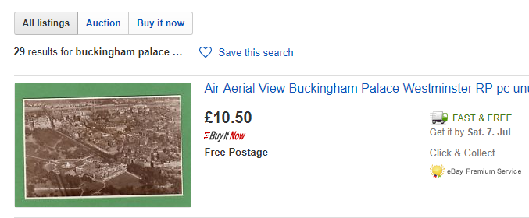
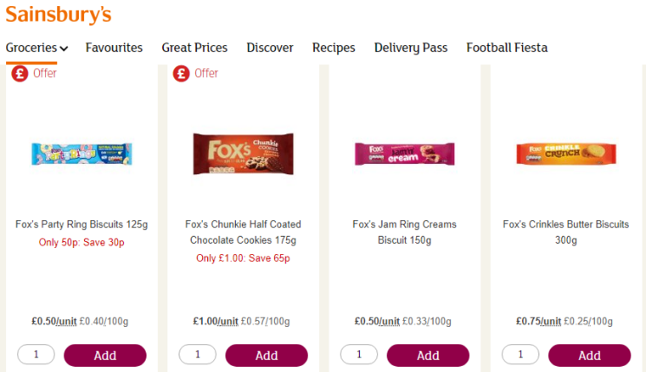
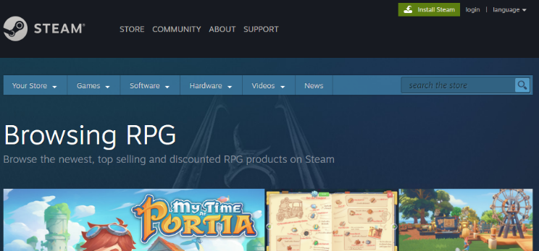
P1.2 – Sales
These are the most common sites we know, sites where the company uses the portal to sell goods direct to the customer either through selection choice on the site then taken from the warehouse or direct from the manufacturer to the customer. Either way the customer does not care as long as the goods arrive.
Over the years these sites have improved their methods and effectiveness to a common standard so the customer knows how to order, pay and select a delivery address that is similar on each site.
Features you will need to explain in your own example definition include:
  Shopping baskets, payment methods, checkouts, logins for return business, selection methods, categories, reviews and feedback and customer support and help.
www.ebay.co.uk
https://www.sainsburys.co.uk
https://store.steampowered.com

Slide 8
P1.2 – Sales
When it comes to benefits of having a sales website you will need to talk about the following points:
For the customer:
  User access to sales without communication
  Repeat purchases made easier
  Ability to review and leave feedback
  The ability to make selections
  The ability to customise purchases (etching, engraving, colours etc.)
For the business:
  24 hour business
  Reduces interactivity
  Ability to track and monitor activity
  Marketing
  Ease of changing product base
  Meeting customer expectations
P1.2 – Task 02 – Using an example, identify the purpose, provision, advantages and benefits, and company support that sales websites give to a business.
www.ebay.co.uk
https://www.sainsburys.co.uk
https://store.steampowered.com

Slide 9
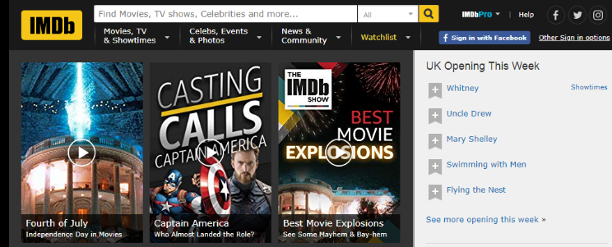
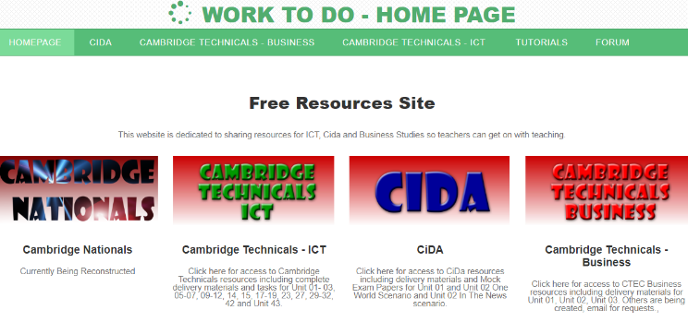
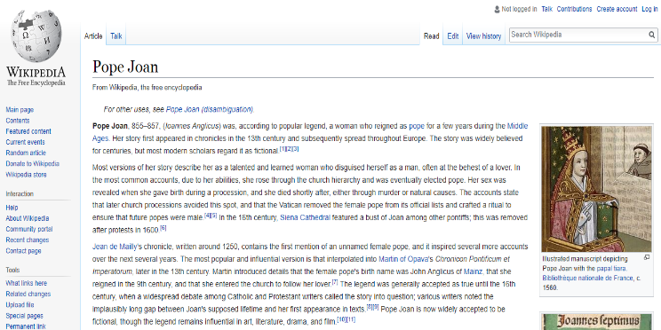
P1.3 – Information
Information sites are like sales sites without purchases, where the user will go there to find the answer to a question, whether it is something simple like facts on a wiki or something more specific like opening times of a theme park or the weather tomorrow.
These sites have a single purpose, to keep you wanting to come back by giving you the answer you need, as quickly, effectively and pleasantly as possible, as well as encouraging you to go beyond the answer to look at other things.
In essence they want to keep you there, either because they are making advertising revenue from your visit, or to make you aware of the company name and product so that you may remember their service in the future, or to provide a service for you to subsidise their paid service elsewhere. For example Imdb.com is free to find information but has a paid section for businesses, the free service provides an intro to the fuller site.
www.imdb.com
www.Enderoth.com
https://en.wikipedia.org

Slide 10
P1.3 – Information
In your analysis of an information site you will need to discuss the advantages to the customer and company of the web purpose.
For the customer you will need to explain features available such as:
  search bar, layout, ease of reading, links to other information, downloadable content for offline reading, verification of sources.
  You may also include features such as bookmarks, logins, ability to edit information or comment on it.
For the business you will need to discuss:
  the purpose, what the business hopes to achieve from the site, how they encourage customers to come back, what the site may be linked to, how it generates funding or how it promotes the company name.
  You may also explain contact details, the links at the bottom of the site, ads, sources and the use of media on the site to benefit the business reputation.
P1.3 – Task 03 – Using an example, identify the purpose, provision, advantages and benefits, and company support that information websites give to a business.
www.imdb.com
www.Enderoth.com
https://en.wikipedia.org

Slide 11

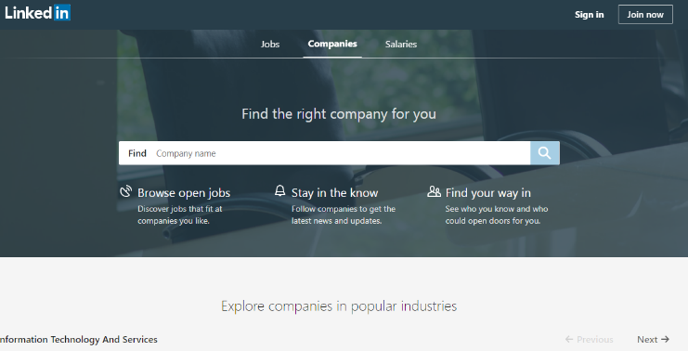
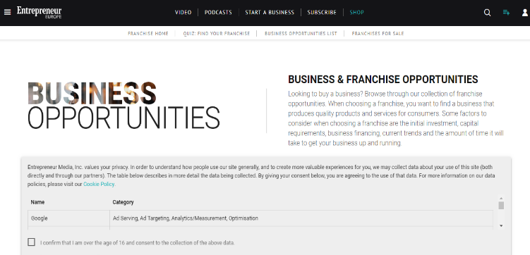
P1.4 – e-commerce
E-commerce site are sites that benefit the daily transactions of a business and help customers deal with the company through another means other than personally or by phone, though they often link to these.
For example, you would not buy a JCB digger from the JCB site but you would find details on there on where to go, who to contact, the nearest local dealer, the specifications of the bigger you wanted, an explanation of the functions and abilities of each vehicle, conditions of lease or purchase.
Sites are not necessarily there to encourage you to buy or lease certain more expensive goods but to merely give you access to the information in order for you to make that choice yourself (informative rather than persuasive).
The customer will then use the information gathered to go to the business or contact the business to further the sale or rent, reducing down the introduction time, the need for staff and the need to
ww.jcb.com
www.linkedin.com/
https://www.entrepreneur.com/

Slide 12
P1.4 – e-commerce
In your analysis of an e-commerce site you will need to discuss the advantages to the customer and company of the web purpose.
For the customer you will need to explain features available such as:
  Layout of information and search ability, technical details, aim of the information level for the ability of the target audience (technical for technical customers), demonstration of products and contact information methods used.
  You may also include links and forms.
For the business you will need to discuss:
  the purpose, what the business hopes to achieve from the site, how it reduces the need for printing brochures, technical information as well as simplified details, corporate colours and design..
  You may also explain contact details, the links at the bottom of the site and the use of media on the site to benefit the business reputation.
P1.4 – Task 04 – Using an example, identify the purpose, provision, advantages and benefits, and company support that e-commerce websites give to a business.
ww.jcb.com
www.linkedin.com/
https://www.entrepreneur.com/

Slide 13
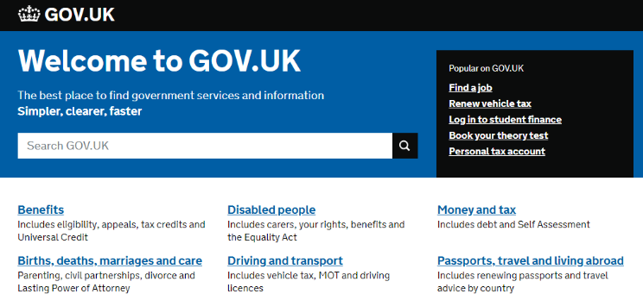
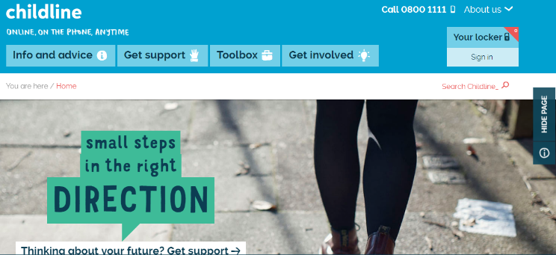
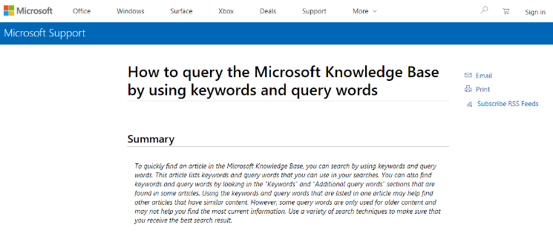
P1.5 – Support Services
There are two kinds of support service websites, those that are created by the government to support the functions of government, and those that are created by businesses to support the functions of their business.
For the government these can be wide ranging from business support, tax, medical, benefits, job seeking, child protection, driving licences, passport etc. Anything the government does as a function for the people of a country is also available on a support website to minimise the need to talk to a person.
These sites are usually text heavy, contain links to pdf’s and are aimed at the needs of the target audience rather than the ability of the target audience.
They also range from the unsecure (gov.uk) to the secure (childline) depending on the needs of the service. Because of the amount of information available on the sites, they will have search facilities, printing options, forms, menus etc. all designed to aid the processes.
For businesses, these can range from websites designed wholly to support the sales of products such as returns, technical help, information and product details, returns support, telephone and contact details etc.
https://www.gov.uk/
https://www.childline.org.uk//
https://support.microsoft.com

Slide 14
P1.5 – Support Services
For businesses support can also include more technical help such as Microsoft’s knowledge base or Novell’s user support that are designed to give complete support to the technical user.
In your analysis of a Support Service site you will need to discuss the advantages to the customer and company of the web purpose.
For the customer you will need to explain features available such as:
  Layout of information and search ability, technical details, aim of the information level for the ability of the target audience (technical for technical customers), demonstration of products and contact information methods used.
  You may also include links, pdf’s and user forms.
For the business you will need to discuss:
  the purpose, what the business hopes to achieve from the site, how it reduces the need for printing documents, technical information as well as simplified details, corporate colours and design.
  You may also explain contact details, the links at the bottom of the site and the use of media on the site to benefit the business reputation.
  P1.5 – Task 05 – Using an example, identify the purpose, provision, advantages and benefits, and company support of Support Services websites give to a business.
https://www.gov.uk/
https://www.childline.org.uk//
https://support.microsoft.com

Slide 15
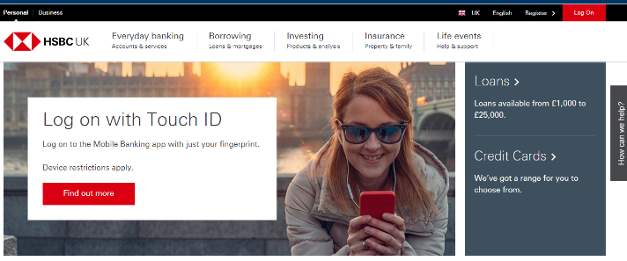
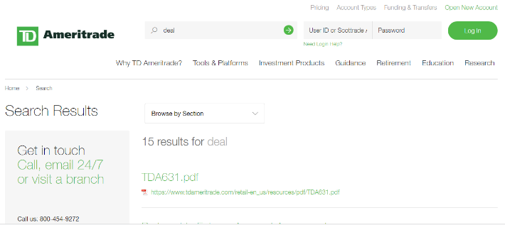
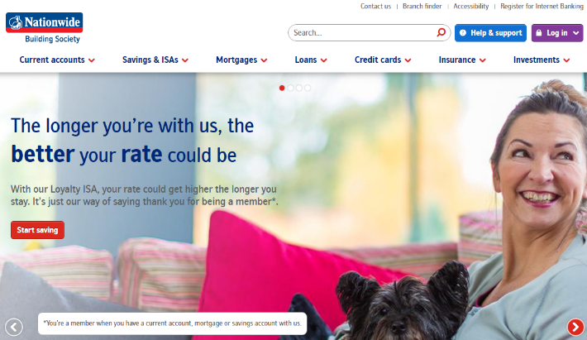
P1.6 – Financial
Financial websites are designed to ease the process of saving, paying or dealing with money and come in different forms, banking, and trading.
Banks use their websites to make it easier for the customer to do most bank transactions remotely from transferring money, paying bills, getting statements, opening and closing accounts or single orders from accounts, and managing moving money internally or eternally.
Support on the sites allows form the user to deal with transactions either via secure online support or email. The main difference in these sites is the level of needed security, additional devices are used to secure the logins and personal information similar to offline support.
Financial trading sites such as share trading, make the process of dealing with shares remotely more present, allows the user to trade, sell, buy and do most of the offline functions from a remote location.
Security is an issue as it deals with money but these sites allow the user to spend more time trading.
https://www.hsbc.co.uk/
https://www.tdameritrade.com
https://www.nationwide.co.uk/

Slide 16
P1.6 – Financial
For traders there are obvious benefits, more time spent, remote access, late night trading on different world markets etc. For Banking the benefits include the need to access a bank at any time when there are none close, urgency and enhanced security.
In your analysis of a Financial site you will need to discuss the advantages to the customer and company of the web purpose.
For the customer you will need to explain features available such as:
  Layout of information and security, access to funds and confirmation of transactions, ability to print statements and onscreen tracking (with shares there will be charts, and tables etc. that are live).
  You may also include links, pdf’s and user forms.
For the business you will need to discuss:
  the purpose, what the business hopes to achieve from the site, how it reduces the need for printing documents, technical information as well as simplified details, corporate colours and design.
  You may also explain contact details, the links at the bottom of the site and the use of media on the site to benefit the business reputation.
  P1.6 – Task 06 – Using an example, identify the purpose, provision, advantages and benefits, and company support of a financial websites give to a business.
https://www.hsbc.co.uk/
https://www.tdameritrade.com
https://www.nationwide.co.uk/

Slide 17
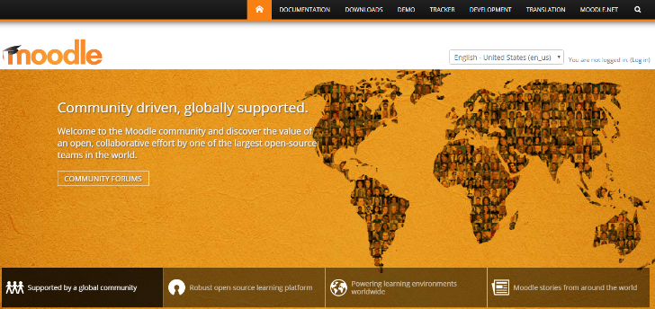
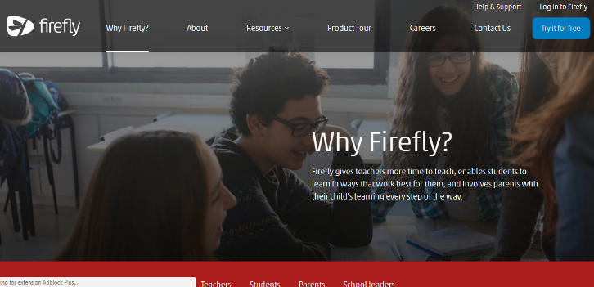
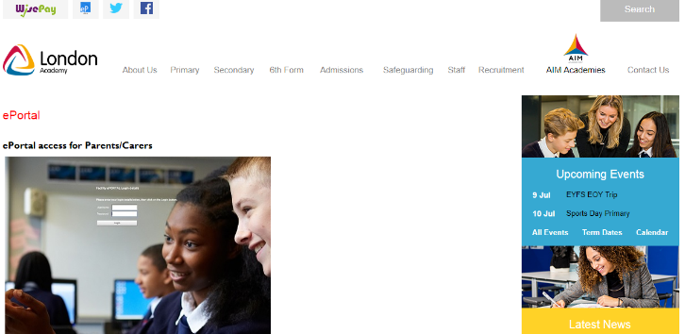
P1.7 – Intranets
Intranets are a purely internal system used by companies for maintaining, demonstrating and using information for their own staff to use. Unlike a secure website, Intranets have all the information stored internally on hard drives and can be accesses either through a link internally or through a link of the company website.
They require a secure login and password that will give the internal user the right to see and navigate through re-selected information set by the company. For example, a school intranet, (all schools have one for students and teachers to put information on, e.g. Moodle, Firefly, ePortal) will have coursework materials for students to access, homework, images of events, descriptions of the courses, and any other help and support the school can provide. In school students login from the website or from an icon and navigate through the pages relevant for them. Teachers will have the rights to upload and change the materials, add students to their courses and set homework.
They usually have three levels of user: administrator, manager and user (or guest), and these three levels restrict what can be done to the intranet pages that are viewed.
In a business version, staff can work on business materials from home, access company materials like they would at work (to a degree) and upload files to the Intranet for other staff to view, change or add to.
https://moodle.org/
https://fireflylearning.com/
https://www.londonacademy.org.uk

Slide 18
P1.7 – Intranets
For your example, you will need to talk about business or a school intranet differently and discuss the look, content and purpose argued against putting materials straight on a website.
In your analysis of an Intranet site you will need to discuss the advantages to the user and company of the information and storage purpose.
For the user you will need to explain features available such as:
  Layout of information and security, access to different levels of information, ability to upload and download documents, how to customise or join areas.
  You may also include links, media types and internal security measures.
For the business you will need to discuss:
  the purpose, what the business hopes to achieve from the site, how it reduces the need for printing documents, technical information as well as simplified details, corporate colours and design.
  You may also explain user levels, and how it benefits schools or businesses if the information is live and constantly updated..
  P1.7 – Task 07 – Using an example, identify the purpose, provision, advantages and benefits, and company support that an intranet gives to a business or a school.
https://moodle.org/
https://fireflylearning.com/
https://www.londonacademy.org.uk

Slide 19
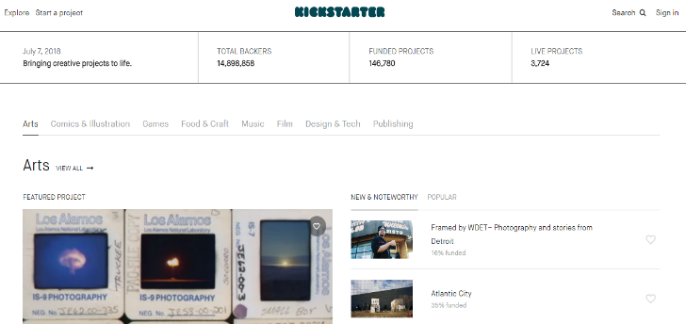
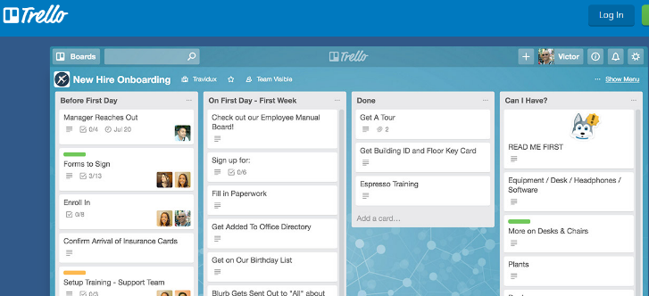
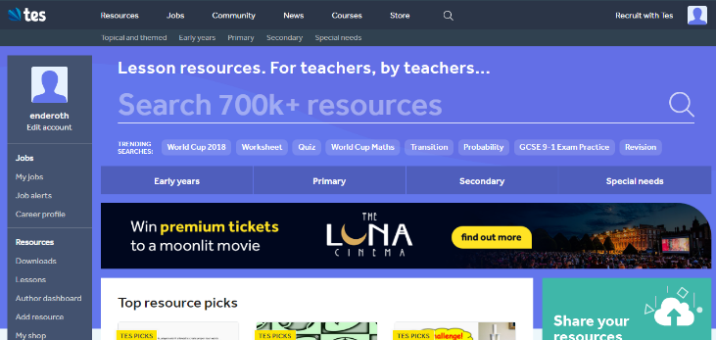
P1.8 – Collaboration
Collaborative websites are designed to allow users and businesses to communicate information for a mutual purpose, with each person adding to a larger bank of information or result. Each user contributes their own part to this, either set as tasks or just ad-hoc.
There are many different types of these, from something as simple as a wiki to more complex projects such as crowdsourcing, or environmental help. As long as it allows users to add their own part, then it is considered collaborative. (This is different from social media as social media does not have a defined end goal).
For example, crowd sourcing sites allow a user to put forward a bid for a project and contributors then fund the project with the potential for gaining something from it at the end. These are usually companies looking for start up funds and will offer usage, advertising or gratitude for funding.
Other collaboration sites include Wikis that allow users with consensus support to add materials and information for a larger purpose, either through writing their own versions or correcting versions that have been written.
Companies like Wikipedia started this way, adding to a larger bank of information over years with collaboration and support of businesses and users.
https://www.kickstarter.com/
https://trello.com/
https://www.tes.com/

Slide 20
P1.8 – Collaboration
For your example, you will need to talk about any collaboration website that benefits from group, user or community support and how these users add information or support to the business.
You should discuss what their purpose is, how they go about it, how users collaborate, what the ultimate goal of the collaboration is and the benefit of the end result.
For the user you will need to explain features available such as:
  Layout of information, how to upload and contribute, the benefits of contributing.
You may also include links, media types, method to verify information and rewards.
For the business you will need to discuss:
  the purpose, what the business hopes to achieve from the site, how it finds users to collaborate, how it displays the information help and support links and contact details.
P1.8 – Task 08 – Using an example, identify the purpose, provision, advantages and benefits, and company support that a collaboration site gives to a business to users.
https://www.kickstarter.com/
https://trello.com/
https://www.tes.com/

Slide 21
LO1 – Assessment Criteria
  P1.1 – Task 01 – Using an example, identify the purpose, provision, advantages and benefits, and company support marketing websites give to a business.
  P1.2 – Task 02 – Using an example, identify the purpose, provision, advantages and benefits, and company support that sales websites give to a business.
  P1.3 – Task 03 – Using an example, identify the purpose, provision, advantages and benefits, and company support that information websites give to a business.
  P1.4 – Task 04 – Using an example, identify the purpose, provision, advantages and benefits, and company support that e-commerce websites give to a business.
  P1.5 – Task 05 – Using an example, identify the purpose, provision, advantages and benefits, and company support of Support Services websites give to a business.
  P1.6 – Task 06 – Using an example, identify the purpose, provision, advantages and benefits, and company support of a financial websites give to a business.
  P1.7 – Task 07 – Using an example, identify the purpose, provision, advantages and benefits, and company support that an intranet gives to a business or a school.
  P1.8 – Task 08 – Using an example, identify the purpose, provision, advantages and benefits, and company support that a collaboration site gives to a business to users.

